Slide 1

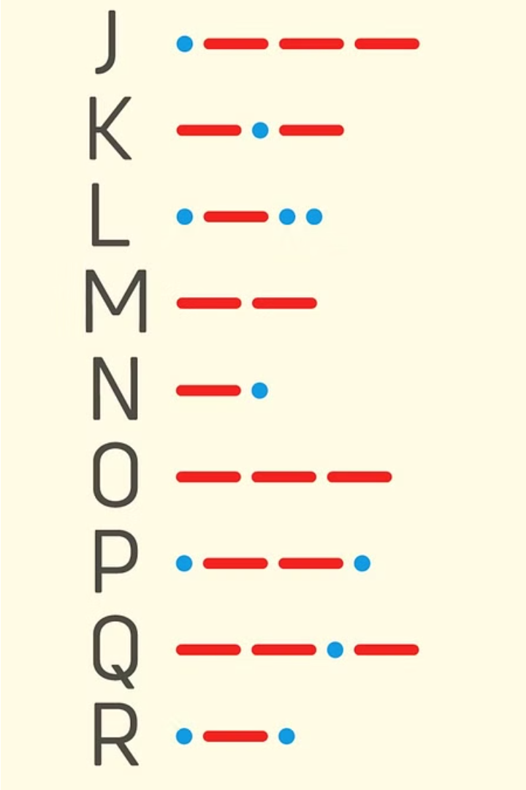
Mastering Morse Code
Morse code is a fascinating method of communication that has played a crucial role in history. Whether you're interested in its historical significance or want to learn a new skill, this guide will provide you with the essential information to start your Morse code journey.

Slide 2
The Origins of Morse Code
1
Samuel F.B. Morse
2
International Standard
Morse code was invented in the 1830s by Samuel F.B. Morse, an American artist and inventor, who developed the code for use with the electric telegraph.
Morse code was later adopted as an international standard for communication, used extensively in maritime, aviation, and military applications.
3
Enduring Legacy
Even in the digital age, Morse code continues to be used by hobbyists, emergency services, and as a backup communication method.

Slide 3
Applications of Morse Code
Emergency Communication
Amateur Radio
Morse code can be a critical means of communication in emergency situations when other methods fail, such as during natural disasters or power outages.
Morse code is still widely used in the amateur radio community, both for personal communication and as a requirement for obtaining certain licenses.
Maritime and Aviation
Historical Preservation
Morse code continues to be used in maritime and aviation applications, particularly as a backup communication method for emergency situations.
Learning Morse code can be a way to honor and preserve the rich history of telecommunications and the role it has played in shaping the world.

Slide 4
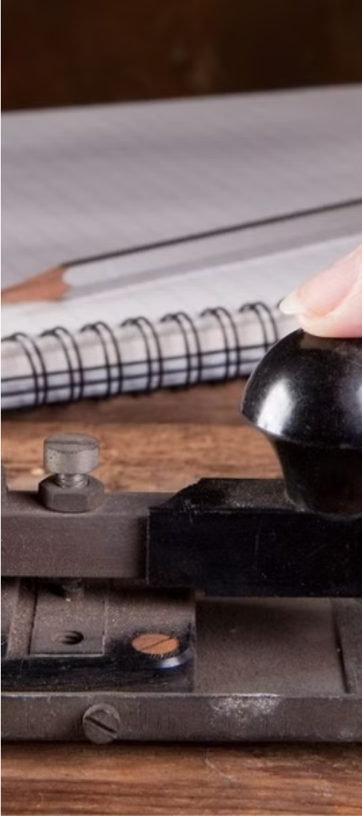



The Future of Morse Code
Evolving with Technology
As communication methods continue to evolve, Morse code has adapted and found new applications in digital and wireless technologies.
Educational Value
Learning Morse code can provide valuable insights into the history of communication and develop skills in pattern recognition and problem-solving.
Enduring Relevance
Despite the rise of modern communication methods, Morse code remains a unique and versatile form of communication that continues to captivate and serve valuable purposes.

Slide 5
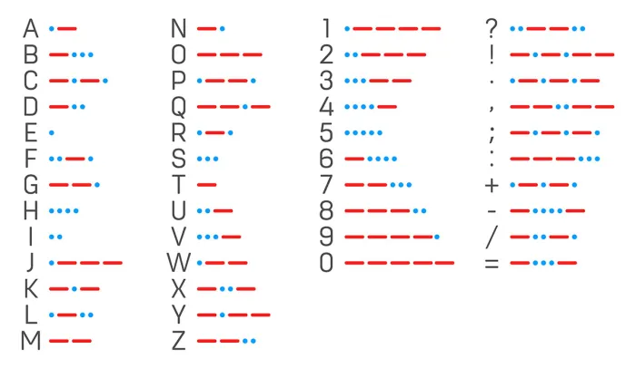
Morse Code Converter
This application allows users to easily convert between text and Morse code, providing a convenient way to transmit and receive messages using the classic telegraph signaling system.

Slide 6
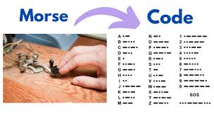
Encoding Messages
Input Text
Conversion Process
The user can enter any sentence or phrase to be converted into Morse code.
The program iterates through each letter in the input and looks up the corresponding Morse code symbol in the provided dictionary.
Morse Code Output
The Morse code representation of the input message is then printed, with each symbol separated by a space.

Slide 7
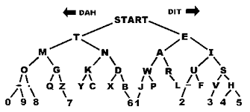
Decoding Morse Code
1
Morse Code Input
2
Conversion Process
The user can enter a series of Morse code symbols, with each symbol separated by a space.
The program splits the input into individual Morse code symbols and then looks up the corresponding letter in the dictionary.
3
Text Output
The original message is reconstructed and printed as the decoded output.

Slide 8
User Experience
1
Encoding
The user can choose to encode a message by typing it in and converting it to Morse code.
2
Decoding
Alternatively, the user can decode a Morse code message by entering the symbols and receiving the corresponding text.
3
Continuous Use
The program allows the user to continue encoding and decoding messages until they choose to stop.

Slide 9
Morse Code Dictionary
Alphabet
Digits
Efficient Encoding
The Morse code dictionary maps each letter of the alphabet to its corresponding Morse code symbol.
The dictionary also includes the Morse code representations for the digits 0 through 9.
The use of this dictionary allows for quick and accurate conversion between text and Morse code.

